Slide 1
Student record manager
Course Instructor: Presented by:
N.AKHILA, M.Tech (Ph.D),
ASSISTANT PROFESSOR,
AIML DEPTARTMENT
25B11AI057 | ANYAM YUVA TEJA SRI
25B11AI164 | BURRA BOBBY
25B11AI292 | EDUPUGANTI TEJASWI
25B11AI329 | GARIKIPATI LIKHITHA

Slide 2
Contents
Project Abstract
Problem Statement & Objectives
Planned Modules / Functions
Users of the system
Modules/Functionalities
Architecture Diagram
Planning and Timeline Diagram
Role of each individual

Slide 3
Project Abstract
The Student Record Manager is a C++ application designed to efficiently manage and organize student information. It replaces manual record maintenance with a structured, object-oriented software solution. The system allows users to add, update, delete, search, and display student records from a centralized system. It can store details such as student ID, name, branch, year, marks, and contact information. The project applies core OOP principles such as classes, encapsulation, inheritance, and polymorphism to provide a modular and reusable design

Slide 4
Problem Statement & Objectives
Problem Statement :
Maintaining student records manually can be time-consuming and may result in data duplication, errors, difficulty in searching records, and loss of information.
Objectives:
Provide a centralized system to manage student records.
Add and store student information efficiently.
Enable searching and viewing of student records.
Allow updating and deleting of existing records.
Reduce manual errors and duplicate entries.
Generate simple student performance reports.

Slide 5
Planned Modules / Functions
Student Management Module – Add, update, delete and display student records.
Search Module – Search students using ID, name, or branch.
Marks Management Module – Store and update marks or academic details.
Record Management Module – Maintain student information systematically.
File Handling Module – Store and retrieve student records from files.
Report Generation Module – Display student details and performance summaries.

Slide 6
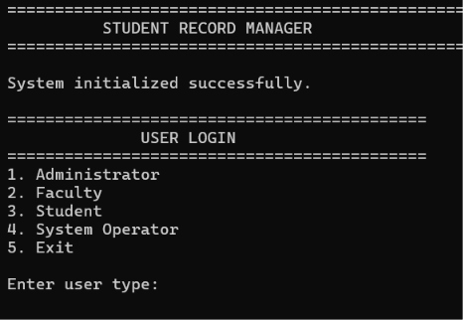
Users of the System
Administrator – Manages all student records.
Faculty – Adds, updates, and views academic information.
Students – Can view their personal and academic records.
System Operator – Maintains and manages stored data.

Slide 7
Modules / Functionalities
Modules / Functionalities :
Student Class – Stores student ID, name, branch, year, and contact details.
Marks Class – Stores subject-wise marks and academic performance.
Search Class/Function – Finds records using student ID or name.
Record Manager – Handles adding, updating, deleting, and displaying records.
File Handler – Saves and retrieves records using file handling.
Report Class – Generates student performance summaries

Slide 8
OOP Concepts Used
Encapsulation
class Student
{
private:
int studentID;
string name;
};
Inheritance
class Faculty : public User
Polymorphism
User* user = &faculty;
user->showMenu(manager);
Abstraction
class User
{
public:
virtual void showMenu(RecordManager& manager) = 0;
};

Slide 9
Architecture Diagram
Presentation Layer
Console / Menu-driven User Interface
Business Logic Layer
Student Manager | Search Manager | Marks Manager | Report Manage
Data Layer
File Handling ( Student, MARKS records)

Slide 10
Planning and Timeline Diagram
W1
W2
W3
W4
W5
W6
W7
Requirement Analysis
System Design (Class/ER Diagrams)
Coding & Module Development
Integration & Testing
Documentation & Final Review

Slide 11
Role of Each Individual
Roll No. | Name | Role / Responsibility
25B11AI057 | Anyam Yuva tejasri | Class design, Event & Registration modules
25B11AI164 | Burra Bobby | Coding – core modules & file handling
25B11AI292 | Edupuganti Tejaswi | Testing, debugging & report generation
25B11AI329 | Garikipati Likhitha | UI design, documentation & presentation

Slide 12


